Slide 1
CSC8503 Revision Lecture

Slide 2
Overview
We’ll first discuss some key features of this year’s paper.
Then, we’ll review the questions in last year’s paper, highlighting the elements we’d need to consider when answering them
We will NOT go through model answers for each question

Slide 3
Exam Key Features
You are permitted to take an approved calculator (see University Regulations, or ask 8th Floor Reception if you need clarification)
Exam is out of 100, and you have 2 hours in which to complete it
ALL sections of ALL questions should be attempted – there are no optional questions
The paper is divided into TWO parts (A and B) – questions within each part should be attempted in order
The parts are NOT equally weighted – keep that in mind when managing your time in the examination itself

Slide 4
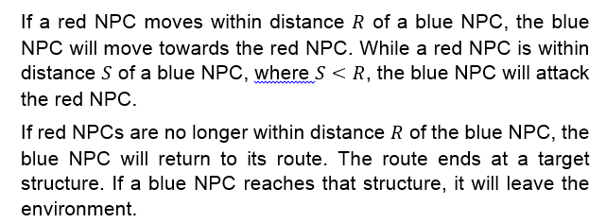
2015/16 Exam Question 1

Slide 5
2015/16 Exam Question 1

Slide 6
Question 1a
What do we need to consider?
Key elements of a FSM are:

Slide 7
Question 1a
What do we need to consider?
Key elements of a FSM are:
States (duh)
Transitions
Trigger Conditions

Slide 8
Question 1a
How many states?
Which states are connected by a transition?
What are those conditions?

Slide 9
Question 1a
How many states?
6 (including destroyed/left environment)
Which states are connected by a transition?
E.g., Following Route would connect to Move to Red NPC
What are those conditions?
Following Route would connect to Move to Red NPC if a Red NPC is present within distance R

Slide 10
Question 1a
Tricky details?
Remember the question stipulated the Blue NPC – so the answer would anticipate trigger conditions explicitly stating “Red” NPC for the distance checks, etc.
The Dead state – people often forget that one
The Dead state is the only state that doesn’t need an exit condition (e.g., it’s the only state you can reach where you don’t have the possibility of changing state further)

Slide 11
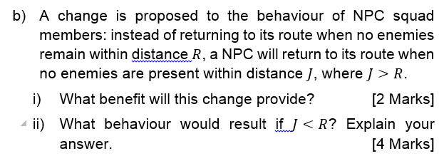
Question 1b
Well, what benefit does this sort of hysteresis provide?
And what happens if we screw up and have J less than R?
Second part is meant to make you think about the actual implementation consequences

Slide 12
Question 1c
Notice that the question’s scenario evolves over the course of the question. This is especially true in this year’s paper, and is the reason you ought to consider the elements of a Part in order.

Slide 13
Question 1c
Need to consider the fact that we’re no longer looking at a point-in-a-circle check
Instead, we’re doing a circle-circle check (sphere-sphere in two dimensions)
Rewrite the S-S check to reflect this

Slide 14
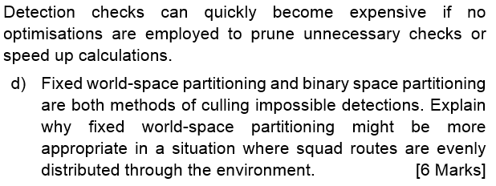
Question 1d)
So, curveball – this is a physics question INSIDE an AI question – how devious.
Meant to make sure you ‘get’ how the elements relate to each other.
Once you get over the initial shock, consider what you’ve memorised about world-space partitioning, and apply it to the scenario. Thoughts?

Slide 15
Question 1e)
And again, curveball. Now we’re talking about the GPU lectures in an AI question.
Again, testing your ability to understand the principles, not mnemonics.
Is this suitable for GPU compute?
If so, why?
If not, why not?

Slide 16
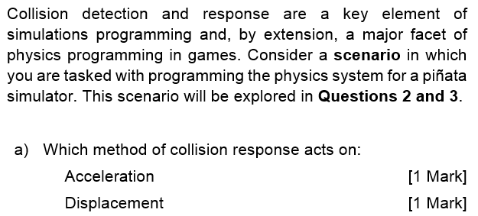
Question 2a
Gift marks if you’ve even glanced at the course content.

Slide 17
Question 2b
2b needs you to think – what’s a piñata?
What elements are important in a piñata simulation?
Thus, which of these two approaches can best provision those elements?

Slide 18
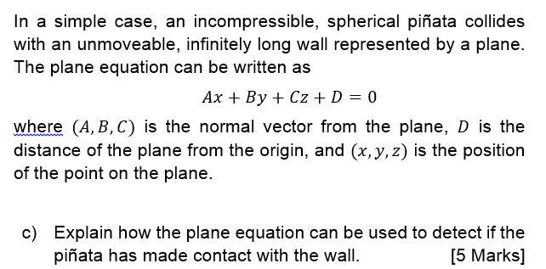
Question 2c
This is a simple sphere-plane intersection check. Explain the equation, and what each element means.
What would happen if this were a polyhedral piñata rather than a sphere?

Slide 19
Questions 2d and 2e
Again, gift marks if you’ve read the handout – what’s the weakness of sphere-plane? How is plane defined?
Trick question.

Slide 20
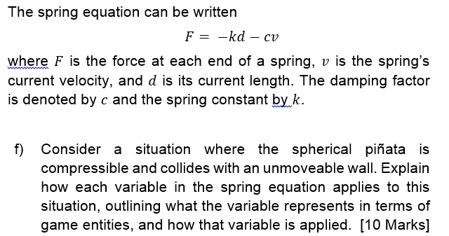
Question 2f

Slide 21
Question 2f
Need to consider each element of the spring equation
What does it mean in this example?
E.g.
F is the force applied to the piñata (because the wall is immovable)
V is the velocity of the piñata at the moment the collision occurs
And so on…

Slide 22
Question 2g
This is bookwork from the handout – it’s one of two inertial tensors you’re meant to be able to recall
What’s the other?

Slide 23
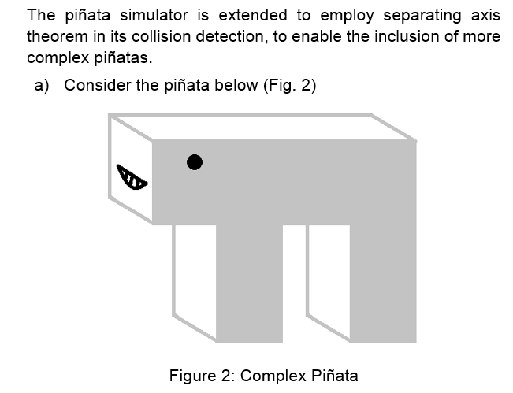
Question 3a

Slide 24
Question 3a
Part i is testing your understanding of SAT – what needs doing to the piñata for SAT to work?
Part ii is ensuring you can explain why that needs to be the case – recall the diagram in the handout, showing the problem.

Slide 25
Question 3b
This is bookwork – the answer is in the handout.
What is the condition that needs to be satisfied?

Slide 26
Questions 3c and 3d
Part c is more bookwork.
And part d is a trick question – what’s our sphere-sphere edge case for SAT?

Slide 27
Question 4
Now, this is where things get fun.
Open up the PDF if you haven’t already, and let’s walk through this question.

Slide 28
Any questions?

